Slide 1

Angular Crash Course
Andrei Mihalciuc
7 July 2017

Slide 2
Agenda
What is this? Why do we need it?
Getting Started
Template syntax – Magic in action
Components – Make it reusable
DI and Services
Navigation
Validation
Pipes & Directives
Http and Rx
Testing

Slide 3

What’s up? Isn’t Asp.Net MVC the best?

Slide 4
Getting Started
Install IDE (Visual Studio Code)
Install NodeJS
Add Angular CLI : npm install -g angular-cli
Create new project :
ng new PROJECT_NAME
cd PROJECT_NAME
ng serve
http://localhost:4200/

Slide 5

Template syntax – Magic in action
{{}} [] () [()] – can you speak English?
ngIf, ngFor
[Hidden] [Disabled]

Slide 6
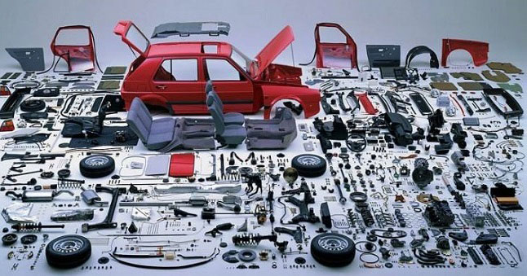
Components – Make it reusable
@Input()
@Output()

Slide 7

DI and Services
Hope you know it.
@Injectable()

Slide 8
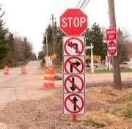
Navigation
routerLink & routerLinkActive
Navigation from code
Get navigation parameters
Route guards

Slide 9

Validation
Template based forms
Reactive forms

Slide 10

Pipes & Directives
Pipes
Directives

Slide 11

Http and Rx
Why RxJs?
Everything is a stream http://rxmarbles.com/
Http service

Slide 12

Testing
Maybe we should skip this?
Jasmine
TestBed, DebugElement

Slide 13


